Slide 1
G440/540 Terrestrial Ecosystem Modeling Uncertainty and Data Assimilation
Instructor: Dr Natasha MacBean

Slide 2
What is Data Assimilation?
Also referred to as “Model-Data Fusion” (MDF) or model-data integration or model optimization.
Data assimilation comprises of a set of statistical techniques aimed at integrating models (prior knowledge of a system) and observations (new information) to improve model predictions and to obtain an estimate of the distribution of the model prediction (i.e. the uncertainty)
Basis of DA → the process of combining data with prior knowledge of the variables of a physical system to obtain an improved estimate of the variables.
P(model, given the data) α P(model) x P(observations given the model)
Based on Bayes’ Theorem → update the prior probability of a hypothesis given new observations or evidence

Slide 3
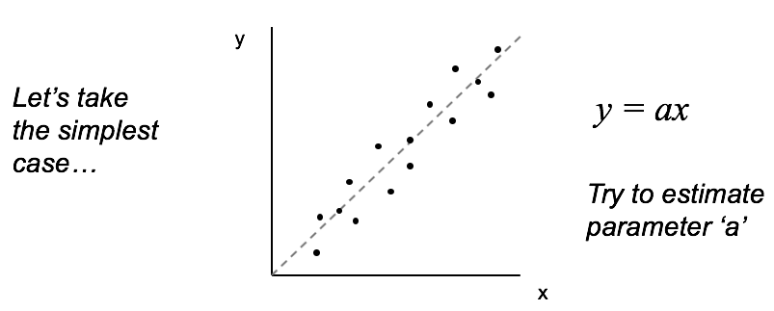
What is Data Assimilation?
Can optimize model state variables, initial conditions, or parameters
In this exercise, we are talking about parameter (and initial condition) optimization
Describe the misfit between the observations and the model simulations, accounting for the uncertainty in both
AIM: try to MINIMIZE this misfit
Model:

Slide 4
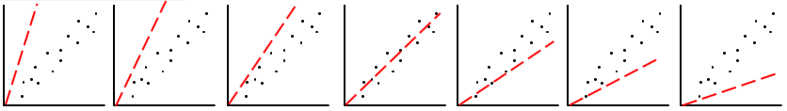
Estimating parameter values
Model:
y = ax

Slide 5
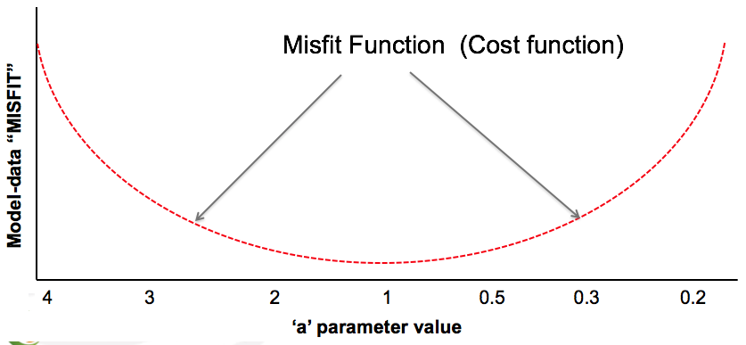
Misfit or cost function
Model:
y = ax

Slide 6
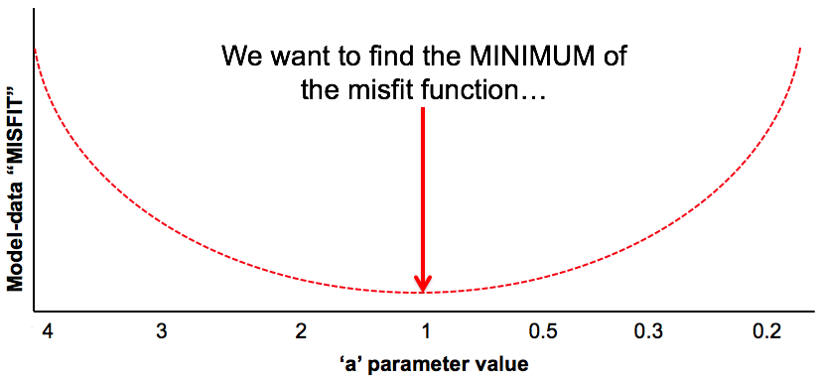
Finding the minimum of the cost function
Model:
y = ax

Slide 7
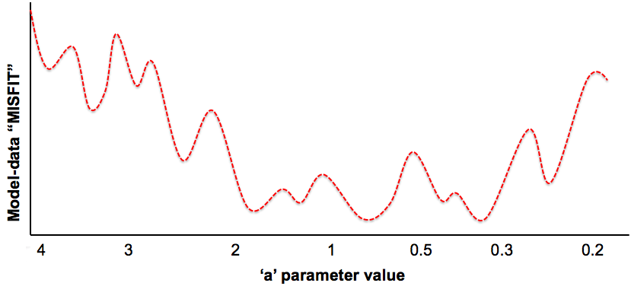
Finding the minimum of the cost function
We want to find the MINIMUM of the misfit function…
BUT! Your misfit function may look like this…!!

Slide 8
Finding the minimum of the cost function
We want to find the MINIMUM of the misfit function…
BUT! Your misfit function may look like this…!!
How do we find the minimum numerically?
Not as easy to find the minimum now!
There may be several different parameter values that all result in as good a fit between the model and the data → “model equifinality”
(often the case with correlated parameters)

Slide 9
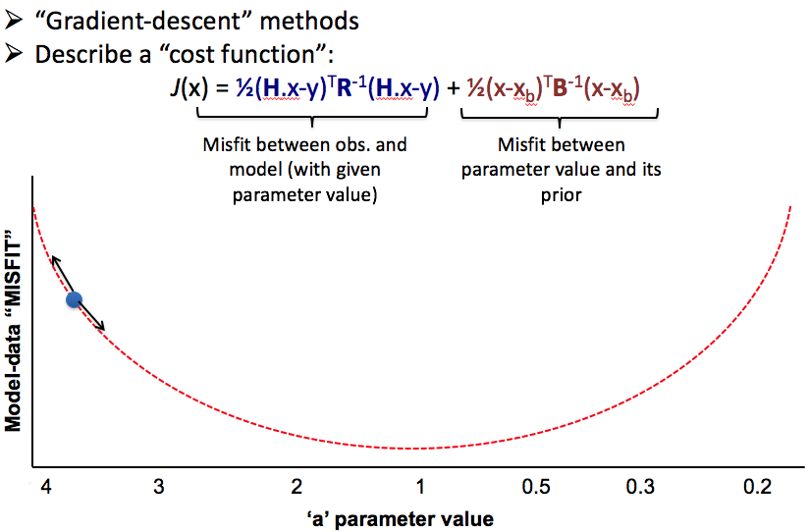
Finding the minimum

Slide 10
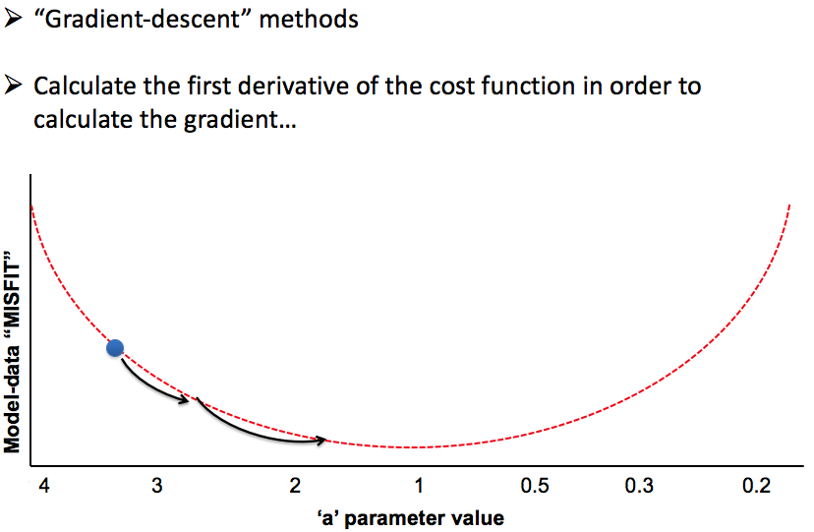
Finding the minimum

Slide 11
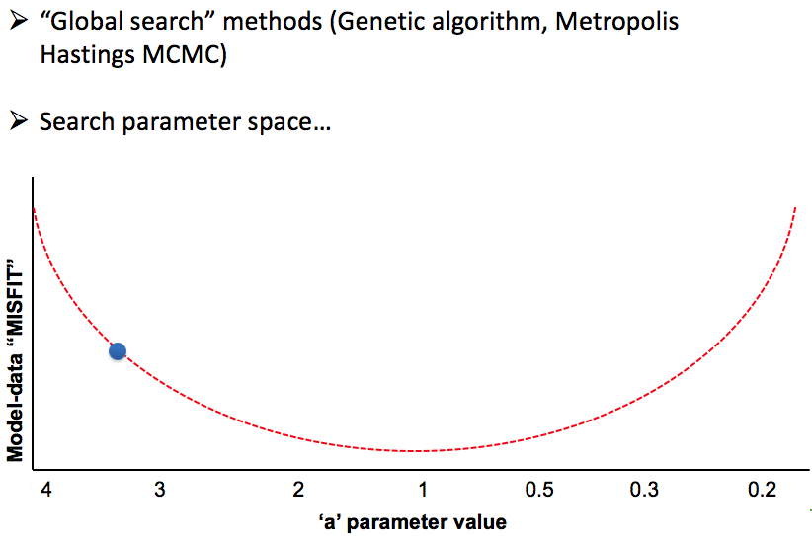
Finding the minimum

Slide 12
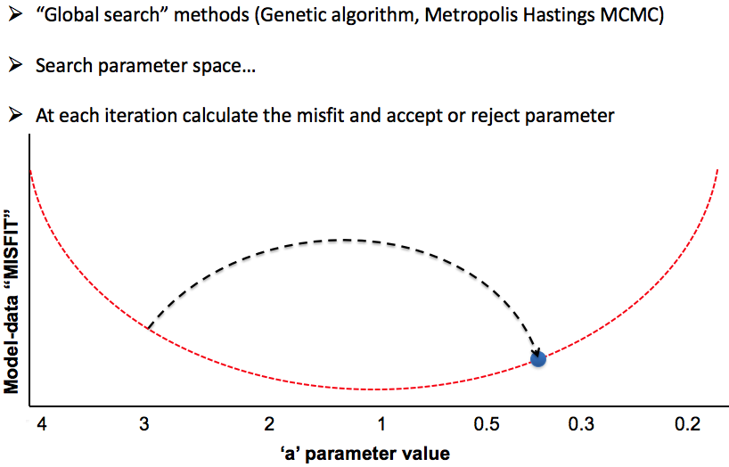
Finding the minimum

Slide 13
Why do we do DA?
Uncertain parameter values are one source of model error → we don’t know how big a source
Want to optimize the parameter values
Want to get a better estimation of the uncertainty on the model simulations
Make better predictions (e.g. C pools into future)
Want to improve the models → DA can help us figure out where there might be important structural errors
Want to improve DA techniques → use new/novel data sources
Important to first get an idea of model sensitivity to parameters/initial conditions
Several methods: Morris, Sobel etc.

Slide 14
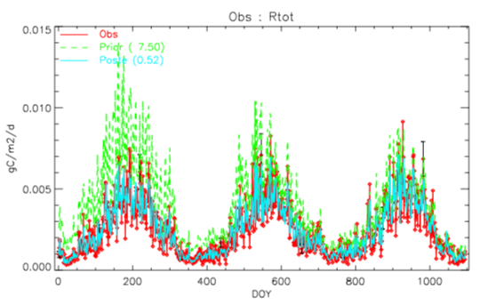
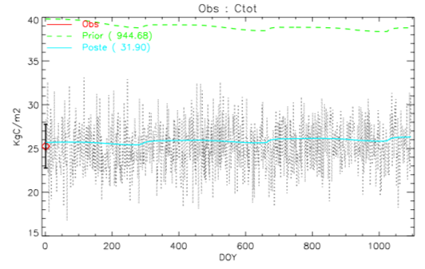
Examples with the 2 pool C model
3 years of Rh_{tot} data and 1 year of C_{tot} data included
Synthetic or “pseudo-obs” experiment → we know the true parameter value
Optimize all parameters
Initial values of parameters are perturbed → try to find the true parameter values
Compare “prior” to “posterior” simulations to observations…

Slide 15
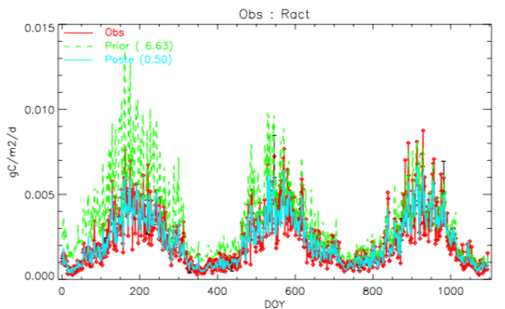
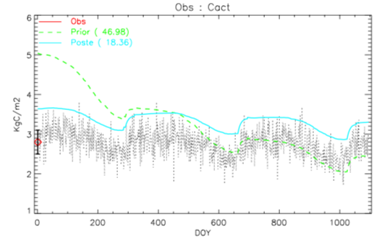
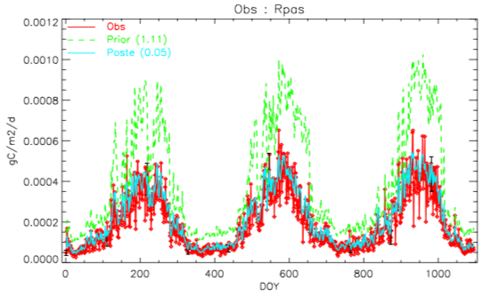
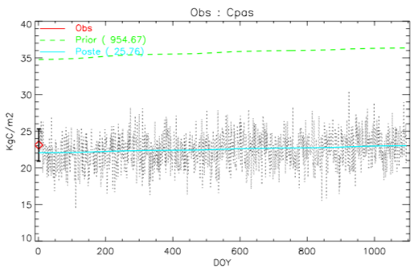
Ract = Rh_{litter} Rpas = Rh_{soil} Cact = C_{litter} Cpas = C_{soil}

Slide 16
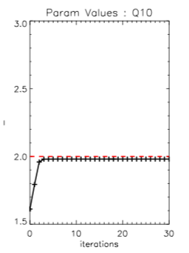
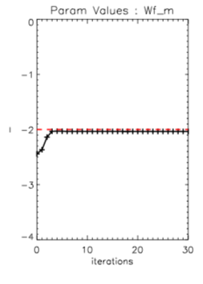
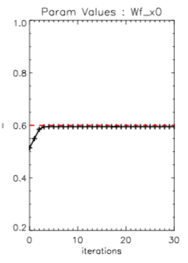
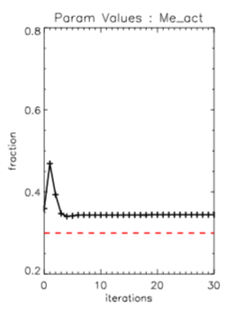
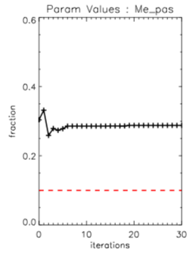
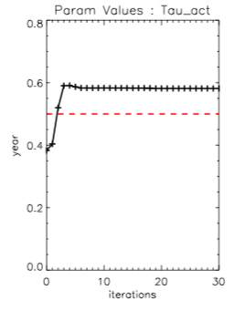
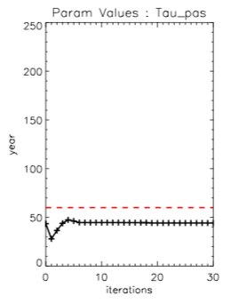
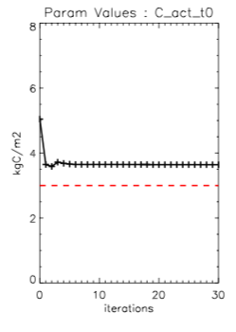
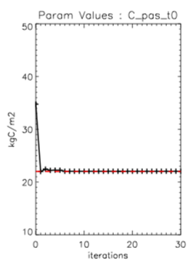
Parameter results
Red dashed line = true value
Black line is each step of the DA algorithm
Final value is the “posterior” value
Parameters for temp. and moisture limitation functions
Microbial efficiency parameters
Turnover time parameters
Initial C stock parameters
act = litter pool pas = soil pool

Slide 17
What can we infer from the DA results?
DA algorithm reduces model-data misfit even if not all the true parameters are found correctly!
Therefore, can’t assume you have the right parameters even if uncertainty (RMSE) is reduced → beware for future simulations
Therefore, need to test parameter values for different times/locations

Slide 18
What can we infer from the DA results?
The true values of parameters related to environmental limitation are accurately estimated
Model highly sensitive to these parameters → NOTE! These parameters the same for both litter and soil pools!
One simple minimum of cost function related to these parameters
Parameters highly correlated (errors correlated) → therefore cannot separate out values (combination of multiple values could work just as well → model equifinality)

Slide 19
What can we infer from the DA results?
The true values of parameters related to environmental limitation are accurately estimated
Model highly sensitive to these parameters→ NOTE! These parameters the same for both litter and soil pools!
One simple minimum of cost function related to these parameters
Parameters highly correlated (errors correlated) → therefore cannot separate out values (combination of multiple values could work just as well → model equifinality)
True value of initial soil C pool content easily found
Because soil C pool much larger contributor to total C stock

Slide 20
What can we infer from the DA results?
The true values of parameters related to environmental limitation are accurately estimated
Model highly sensitive to these parameters → NOTE! These parameters the same for both litter and soil pools!
One simple minimum of cost function related to these parameters
Parameters highly correlated (errors correlated) → therefore cannot separate out values (combination of multiple values could work just as well → model equifinality)
True value of initial soil C pool content easily found
Because soil C pool much larger contributor to total C stock
True value of initial litter C pool content not found
Because litter C pool not as large contributor to total C stock

Slide 21
What can we infer from the DA results?
The true values of parameters related to environmental limitation are accurately estimated
Model highly sensitive to these parameters → NOTE! These parameters the same for both litter and soil pools!
One simple minimum of cost function related to these parameters
Parameters highly correlated (errors correlated) → therefore cannot separate out values (combination of multiple values could work just as well → model equifinality)
True value of initial soil C pool content easily found
Because soil C pool much larger contributor to total C stock
True value of initial litter C pool content not found
Because litter C pool not as large contributor to total C stock
Microbial efficiency and turnover time parameters not as accurately found
Parameters not as sensitive as others or highly correlated

Slide 22
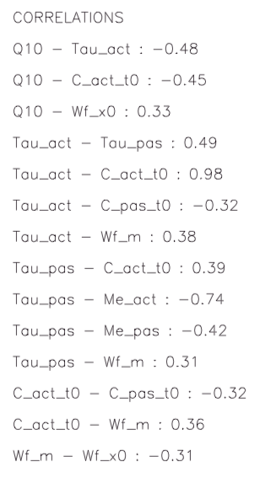
Parameter correlations
act = litter pool pas = soil pool
Number of high correlations (both +ve and –ve)
Can result in multiple combinations of parameter values that reduce model-data misfit (especially if observation or model error is quite high)

Slide 23
What would alter the results?
Different uncertainty on the model or observations (lower initial uncertainty = more constraint in optimization)
Higher number of observations (more years, more C pool measurements)
Lower “degrees of freedom” → decrease number of parameters in optimization
OR better prior information on parameters (e.g. if knew turnover time for one pool)

Slide 24
In-class exercise
Compare these results (called “test1.pdf”) to results from three other tests:
Test 2: Only Rh_{tot} observations included in optimization/DA experiment
Test 3: Only C_{tot} observations included in optimization
Test 4: Only Rpas, Ract, Cpas, Cact (i.e. Rh_{litter}, Rh_{soil}, C_{litter}, C_{soil}) included in optimization and NOT total Rh or C)
When answering the questions, think about which variables will be sensitive to which parameters.
For example, Rh_{litter} and C_{litter} probably more sensitive to litter pool-related parameters.
Also think about what might have a stronger impact on the optimization.
For example, soil C pool bigger than litter C pool; therefore, could dominate…

